Slide 1

Signals & System
Analysis of ECG Signal
Objectives
Finding bpm (beats /minutes)
Final Result
Introduction
Working
Presented By :
Muhammad Muzammil
Akif Ejaz
Muhammad Mubeen

Slide 2

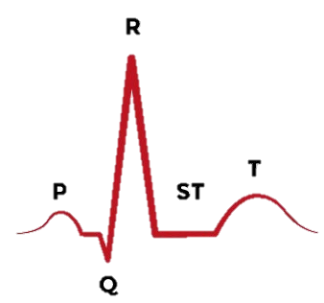

Signal Shape and Properties
Objectives
Final Result
Introduction
Working
Problem
Techniques
Team
Breakdown
Interesting
about

Slide 3


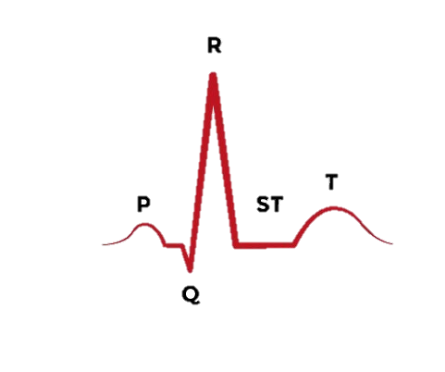
What we have to do ?
Need to Locate R-Waves
Objectives
Final Result
Working
Breakdown
Interesting
2 Ways
-> Threshold Set
-> Correlation

Slide 4

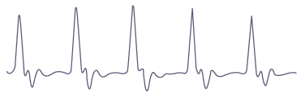
Threshold Setting !
We set a threshold based on the highest value & Lowest value and compare signal , if signal value at particular point reaches threshold or crosses we count that as R-Wave
Feature engineering is the process of transforming raw data into features that better represent the underlying problem to the predictive models, resulting in improved model accuracy on unseen data.
“At the end of the day, some machine learning projects succeed and some fail. What makes the difference? Easily the most important factor is the features used.”
— Prof. Pedro Domingos
“The algorithms we used are very standard for Kagglers. We spent most of our efforts in feature engineering”
— Xavier Conort,
Introduction
Final Result
Working
Problem
Techniques
Team
Breakdown
Interesting
about

Slide 5
Correlation Method
Feature engineering is the process of transforming raw data into features that better represent the underlying problem to the predictive models, resulting in improved model accuracy on unseen data.
“At the end of the day, some machine learning projects succeed and some fail. What makes the difference? Easily the most important factor is the features used.”
— Prof. Pedro Domingos
“The algorithms we used are very standard for Kagglers. We spent most of our efforts in feature engineering”
— Xavier Conort,
We take small part of signal and take convolution with ECG signal, and count the number of times small signal matches the original signal.
Final Result
Objectives
Working
Problem
Techniques
Team
Breakdown
Interesting
about

Slide 6
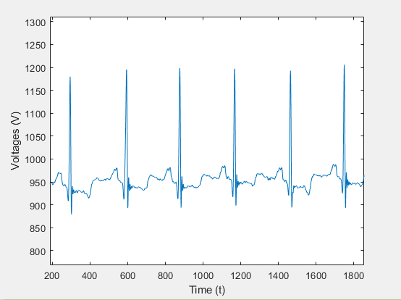
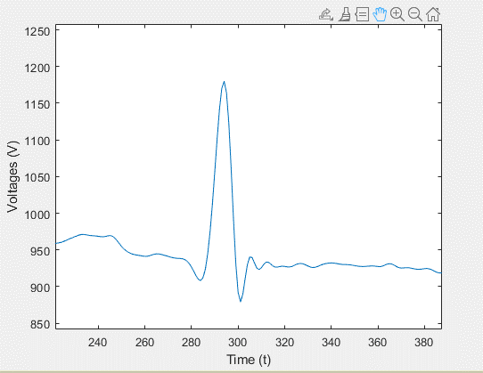
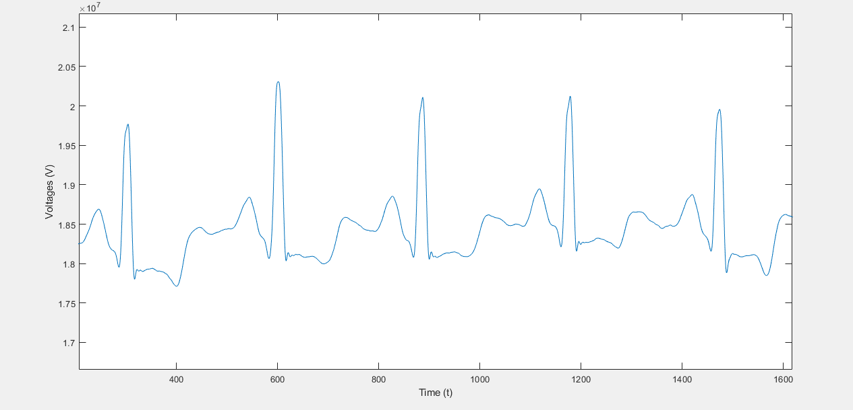
Feature engineering is the process of transforming raw data into features that better represent the underlying problem to the predictive models, resulting in improved model accuracy on unseen data.
“At the end of the day, some machine learning projects succeed and some fail. What makes the difference? Easily the most important factor is the features used.”
— Prof. Pedro Domingos
“The algorithms we used are very standard for Kagglers. We spent most of our efforts in feature engineering”
— Xavier Conort,
Introduction
Final Result
Objectives
Working
Problem
Working
Techniques
Team
Breakdown
Interesting
about

Slide 7
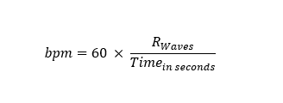
Feature engineering is the process of transforming raw data into features that better represent the underlying problem to the predictive models, resulting in improved model accuracy on unseen data.
“At the end of the day, some machine learning projects succeed and some fail. What makes the difference? Easily the most important factor is the features used.”
— Prof. Pedro Domingos
“The algorithms we used are very standard for Kagglers. We spent most of our efforts in feature engineering”
— Xavier Conort,
Final Result
Objectives
Problem
Working
Techniques
Pros & Cons
Team
Breakdown
introduction
Interesting
Applications
Final Obs.
about
Correlation Method > Threshold Setting

Slide 8

Feature engineering is the process of transforming raw data into features that better represent the underlying problem to the predictive models, resulting in improved model accuracy on unseen data.
“At the end of the day, some machine learning projects succeed and some fail. What makes the difference? Easily the most important factor is the features used.”
— Prof. Pedro Domingos
“The algorithms we used are very standard for Kagglers. We spent most of our efforts in feature engineering”
— Xavier Conort,
Thank You!
Objectives
Preprocessing
End
Models
Techniques
Methods
Breakdown
Interesting
Thank You
about

